Slide 1
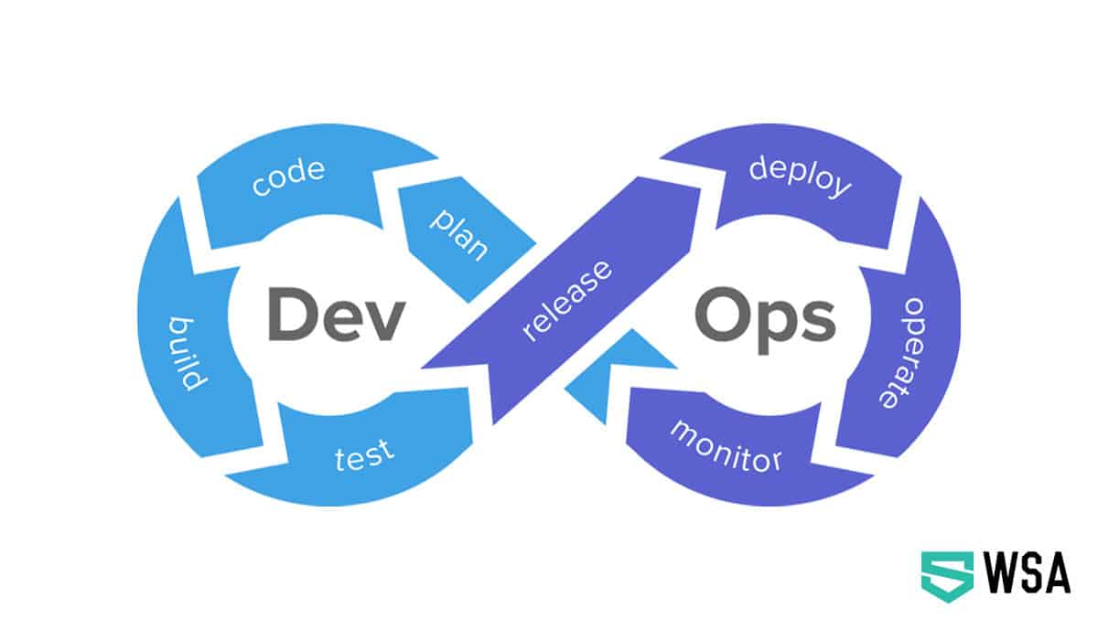

Slide 2
What is DevOps
A compound of development (Dev) and operations (Ops), DevOps is the union of people, process and technology to continually provide value to customers.
What does DevOps means for the team ?
DevOps enable formerly siloed roles - development , IT operations , QA and security to collaborate and coordinate to produce better , more reliable products, BY adopting a DevOps culture along with DevOps practices and tools , teams gain the ability to better respond to customer needs.

Slide 3
What is Azure DevOps
Azure DevOps provides developer services for allowing teams to plan work, collaborate on code development, and build and deploy applications. Azure DevOps supports a collaborative culture and set of processes that bring together developers, project managers, and contributors to develop software. It allows organizations to create and improve products at a faster pace than they can with traditional software development approaches.
Azure DevOps provides integrated features that you can access through your web browser or IDE client.
Azure repo , Azure boards , Azure artifacts , Azure Pipelines and Azure Test plans .

Slide 4
Advantages of Azure DevOps
We have timely access to new features , as Azure updates its devops content frequently from every 3 months .
No upgrades to worry about , as you don’t need to patch up with the tool chain because azure is a SAAS product.
It is reliable , as it has got 24x7 support and 99% SLA.
It is flexible and more secured
It is a hybrid platform , as you can work or integrate simultaneously with other cloud platforms like AWS and GCP .

Slide 5
Why we use Azure DevOps
Helps maintaining versioning of the code easily with git and azure repos
You can use Azure boards , which is a agile development for task management , which can be very crucial for project management.
It provides a robust platform on which you can deploy your applications in a pipeline allowing for continuous integration and deployment
It is an open platform , every user can contribute to its working or community.
It has azure artifacts manager in which you can manage your build and work through it.

Slide 6
Services offered by Azure DevOps

Slide 7
Some of the commonly listed services and there use are -
Azure Dashboards - you can add , configure user from dashboard , configure projects and quickly go to different areas of your project.
Azure repo’s and files - From Repos, you gain access to your source control Git-based or Team Foundation Version Control (TFVC) repositories to support version control of your software projects. These repositories are private.
Azure Boards - From Boards, you gain access to Agile tools to support planning and tracking work.
Continuous Integration and Deployment -
You can define builds to automatically run whenever a team member checks in code changes.
Your build pipelines can include instructions to run tests after the build runs.
Release pipelines support managing deployment of your software builds to staging or production environments.

Slide 8
How does the flow works in Azure pipeline

Slide 9
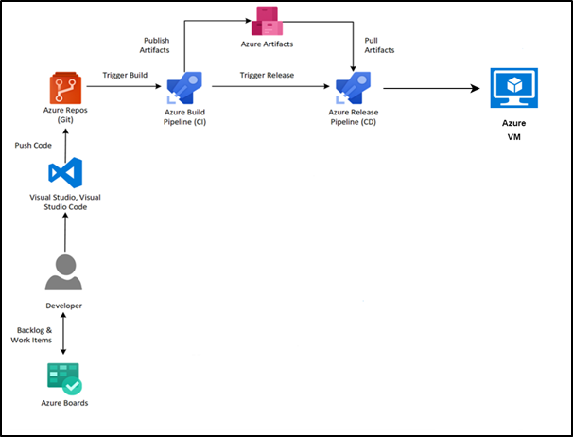

Slide 10
Types of Pipelines and there usage in azure devops
Azure Pipelines automatically builds and tests code projects to make them available to others. It works with just about any language or project type. Azure Pipelines combines continuous integration (CI) and continuous delivery (CD) to test and build your code and ship it to any target.
Continuous Integration (CI) is the practice used by development teams of automating merging and testing code. Implementing CI helps to catch bugs early in the development cycle, which makes them less expensive to fix. Automated tests execute as part of the CI process to ensure quality. Artifacts are produced from CI systems and fed to release processes to drive frequent deployments. The Build service in Azure DevOps Server helps you set up and manage CI for your applications.
Continuous Delivery (CD) is a process by which code is built, tested, and deployed to one or more test and production environments. Deploying and testing in multiple environments increases quality. CI systems produce deployable artifacts, including infrastructure and apps. Automated release processes consume these artifacts to release new versions and fixes to existing systems.

Slide 11
There are generally two types of pipelines in Azure DevOps -
Classic pipeline
Yaml Pipeline
Classic pipelines - They are generally the readymade templates that is used by azure devops. They are readymade templates that can be used to deploy code in respective server’s.
Yaml pipelines - This are the handmade written code for pipelines in Azure devops. This are not premade , we have to configure it and give the respective process and steps.
Azure pipeline terms -
Agent - It is a virtual software OS in which your pipeline runs . It is of two types

Slide 12
Microsoft hosted agent -
With Microsoft-hosted agents, maintenance and upgrades are taken care of for you. Each time you run a pipeline, you get a fresh virtual machine for each job in the pipeline. The virtual machine is discarded after one job (which means any change that a job makes to the virtual machine file system, such as checking out code, will be unavailable to the next job).
Self hosted Agent -
An agent that you set up and manage on your own to run jobs is a self-hosted agent. You can use self-hosted agents in Azure Pipelines or Azure DevOps Server, formerly named Team Foundation Server (TFS). Self-hosted agents give you more control to install dependent software needed for your builds and deployments. Also, machine-level caches and configuration persist from run to run, which can boost speed.
Approvals -
Approvals define a set of validations required before a deployment runs. Manual approval is a common check performed to control deployments to production environments.

Slide 13
Artifact -
An artifact is a collection of files or packages published by a run. Artifacts are made available to subsequent tasks, such as distribution or deployment.
Continuous Delivery -
Continuous delivery (CD) is a process by which code is built, tested, and deployed to one or more test and production stages. Deploying and testing in multiple stages helps drive quality. Continuous integration systems produce deployable artifacts, which include infrastructure and apps. Automated release pipelines consume these artifacts to release new versions and fixes to existing systems.
Continuous Integration -
Continuous integration (CI) is the practice used by development teams to simplify the testing and building of code. CI helps to catch bugs or problems early in the development cycle, which makes them easier and faster to fix. Automated tests and builds are run as part of the CI process. The process can run on a set schedule, whenever code is pushed, or both. Items known as artifacts are produced from CI systems.

Slide 14
Deployment -
For Classic pipelines, a deployment is the action of running the tasks for one stage, which can include running automated tests, deploying build artifacts, and any other actions are specified for that stage.
Deployment Group -
A deployment group is a set of deployment target machines that have agents installed. A deployment group is just another grouping of agents, like an agent pool. You can set the deployment targets in a pipeline for a job using a deployment group.
Environment -
An environment is a collection of resources, where you deploy your application. It can contain one or more virtual machines, containers, web apps, or any service that's used to host the application being developed.

Slide 15
Terms used in Azure YAML pipelines

Slide 16
Job -
A stage contains one or more jobs. Each job runs on an agent. A job represents an execution boundary of a set of steps. All of the steps run together on the same agent. Jobs are most useful when you want to run a series of steps in different environments. For example, you might want to build two configurations - x86 and x64. In this case, you have one stage and two jobs. One job would be for x86 and the other job would be for x64.
Stage -
A stage is a logical boundary in the pipeline. It can be used to mark separation of concerns (for example, Build, QA, and production). Each stage contains one or more jobs. When you define multiple stages in a pipeline, by default, they run one after the other.
Step -
A step is the smallest building block of a pipeline. For example, a pipeline might consist of build and test steps. A step can either be a script or a task. A task is simply a pre-created script offered as a convenience to you.
Task -
A task is the building block for defining automation in a pipeline. A task is packaged script or procedure that has been abstracted with a set of inputs.
Trigger -
A trigger is something that's set up to tell the pipeline when to run. You can configure a pipeline to run upon a push to a repository, at scheduled times, or upon the completion of another build. All of these actions are known as triggers

Slide 17
YAML PIPELINE EXPLANATION

Slide 18
trigger:
- main
pool:
vmImage: 'ubuntu-latest'
steps:
- task: NodeTool@0
inputs:
versionSpec: '16.x'
displayName: 'Install Node.js'
- script: |
npm install
displayName: 'npm install'
- script: |
npm run build
displayName: 'npm build'

Slide 19
- task: CopyFiles@2
inputs:
sourceFolder: '$(Build.SourcesDirectory)'
contents: '*.tgz'
targetFolder: $(Build.ArtifactStagingDirectory)/npm
displayName: 'Copy npm package'
- task: CopyFiles@2
inputs:
sourceFolder: '$(Build.SourcesDirectory)'
contents: 'package.json'
targetFolder: $(Build.ArtifactStagingDirectory)/npm
displayName: 'Copy package.json'
- task: PublishPipelineArtifact@1
inputs:
targetPath: '$(Build.ArtifactStagingDirectory)/npm'
artifactName: npm
displayName: 'Publish npm artifact'

Slide 20
Trigger - It is generally used in pipeline for revoke process . It tell when should the pipeline will run .
Pool - It is the virtual server ie a agent which runs the pipeline
Steps - Steps which we include to run the pipeline ie 1st step is about to install the node js on agent
Script - It is used to run a particular command in pools
Task - This command is generally used to copy files or folder from any of the commands related to system work .
The first task will copy package from build directory to npm package directory
Second task will generally copy the npm package from Source directory to npm directory
Third task will publish the NPM artifact

